Slide 1




Proofs by Contradiction
A proof by contradiction is based on the fact that either a
statement is
true or it is false that the statement to
but not both. Hence the be proved is false, leads
supposition,
logically to a contradiction, impossibility or absurdity, then the supposition must be false. Accordingly, the given statement must be true.
The method of proof by contradiction may be summarized as follows:
Suppose the statement to be proved is false.
Show that this supposition leads logically to a contradiction.
Conclude that the statement to be proved is true.

Slide 2
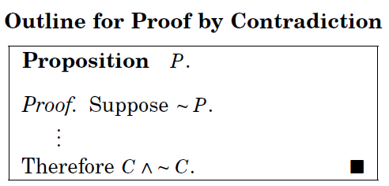
Basic Idea
Assume that the statement we want to prove is false, and then show that this assumption leads to nonsense!
We are then led to conclude that we were wrong to assume the statement was false,
so the statement must be true.

Slide 3


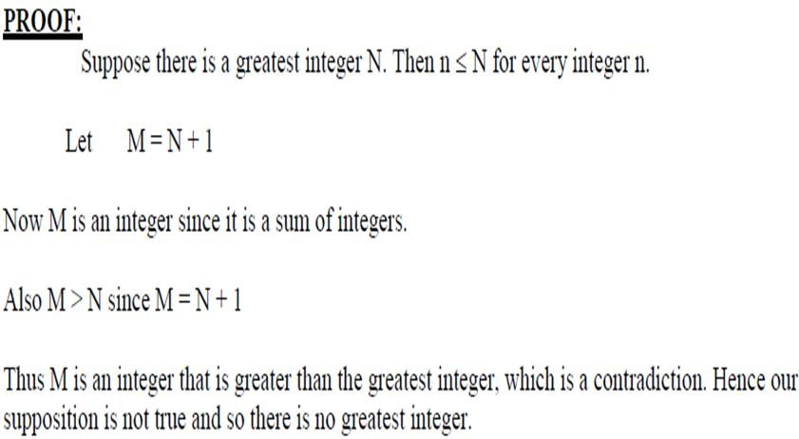

Slide 4
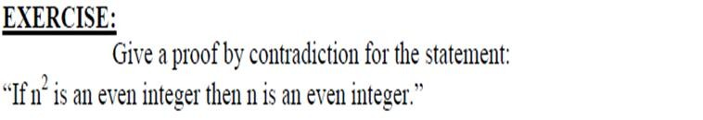
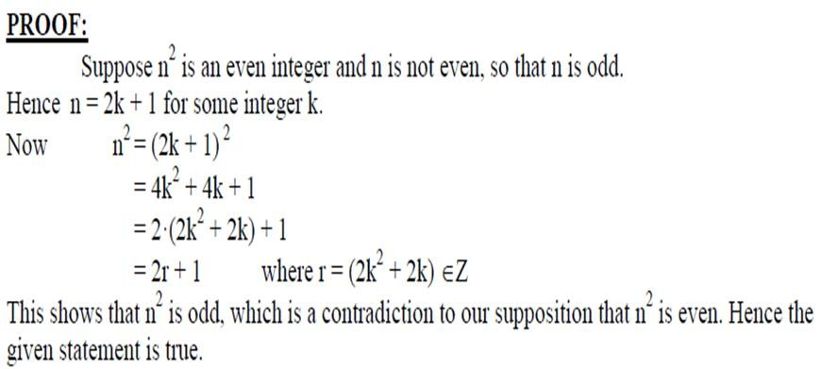

Slide 5

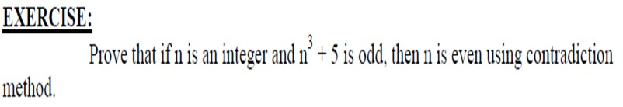
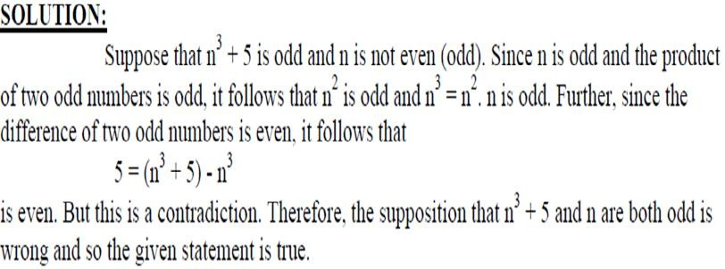

Slide 6

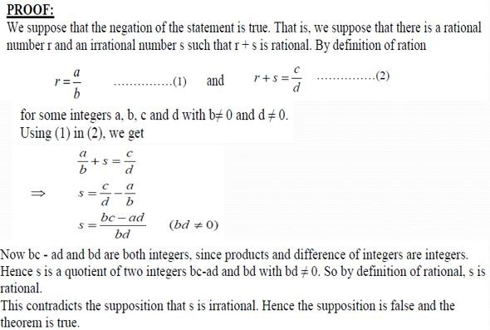

Slide 7

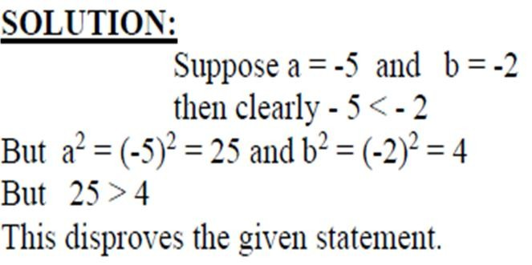
PROOF BY COUNTER EXAMPLE

Slide 8
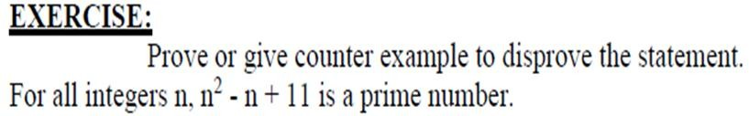
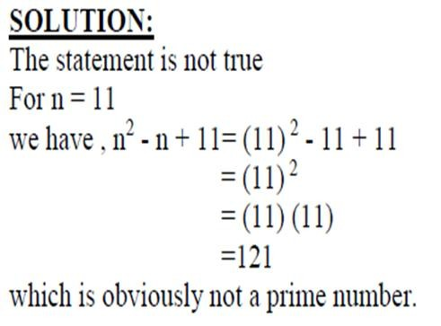

Slide 9


Shoaib Raza

Slide 10
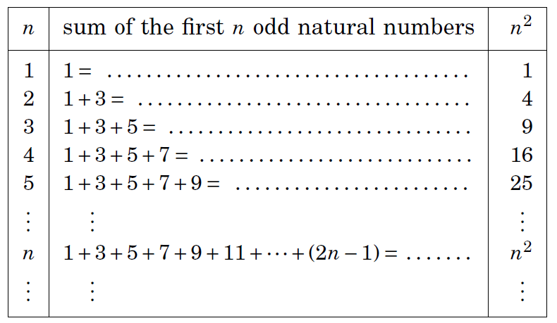
Conjecture: The sum of the first n odd natural numbers equals n².

Slide 11
An infinite ladder
Suppose that we have an infinite ladder, and we want to know whether we can reach every step on this ladder.
We know two things:
We can reach the first rung of the ladder.
If we can reach a particular rung of the ladder, then we can reach the next rung.

Slide 12
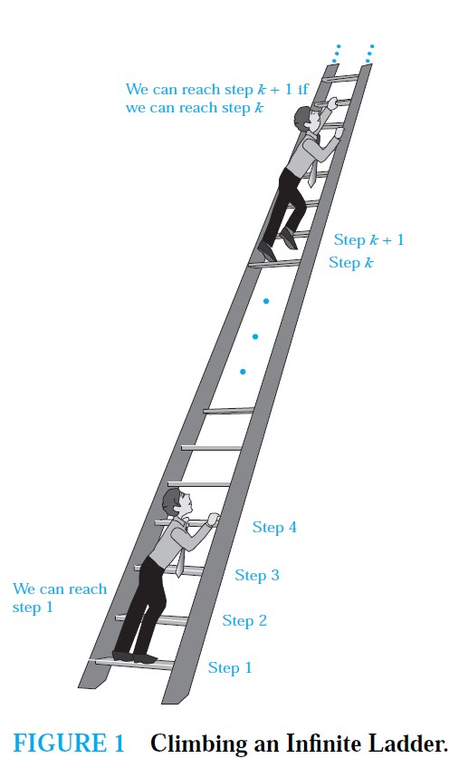

Slide 13
Mathematical Induction
Mathematical statements assert that a property is true for
all positive integers.
Proofs using mathematical induction have two parts.
First, they show that the statement holds for the positive integer 1 (base case).
Second, they show that if the statement holds for a positive integer then it must also hold for the next larger integer. (inductive case)
The method can be extended to prove statements about more general well-founded structures, such as trees; this generalization, known as structural induction, is used in mathematical logic and computer science.

Slide 14
NOTE
It is extremely important to note that mathematical induction can be used only to prove results obtained in some other way.
It is not a tool for discovering formulae or theorems.
Mathematicians sometimes find proofs by mathematical induction unsatisfying because they do not provide insights as to why theorems are true.
You can prove a theorem by mathematical induction even if you do not have the slightest idea why it is true!

Slide 15
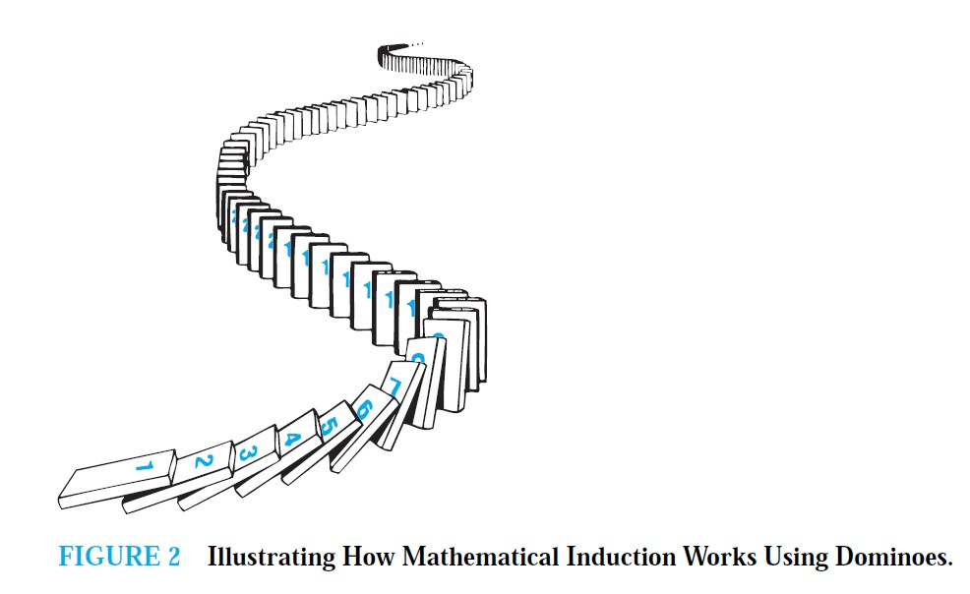

Slide 16

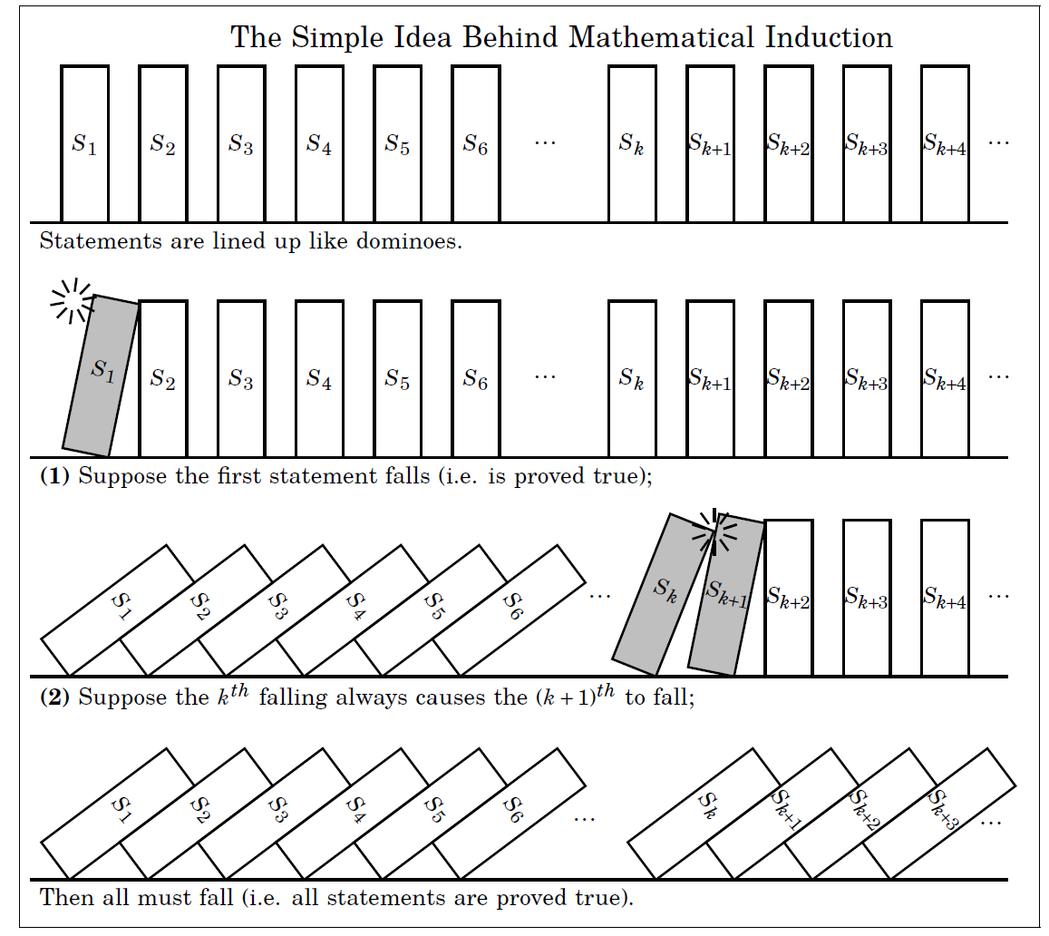

Slide 17

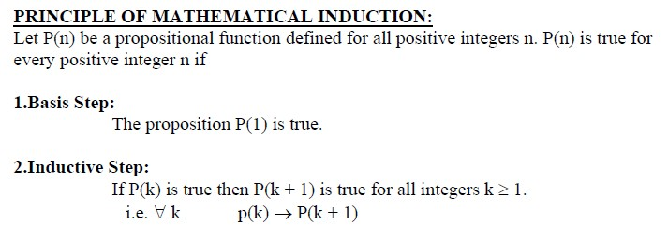

Slide 18
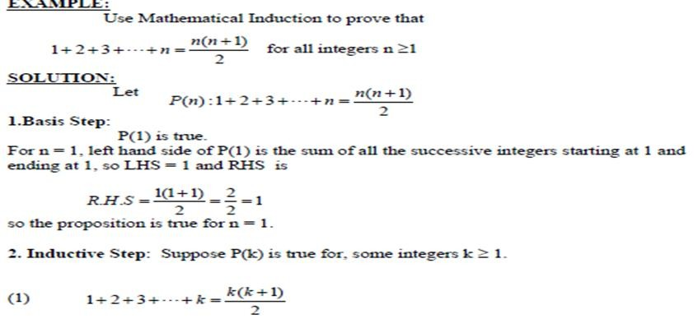

Slide 19
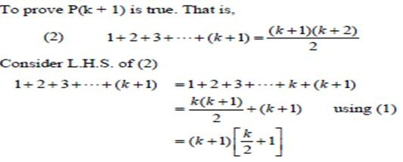
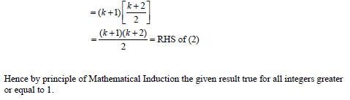

Slide 20
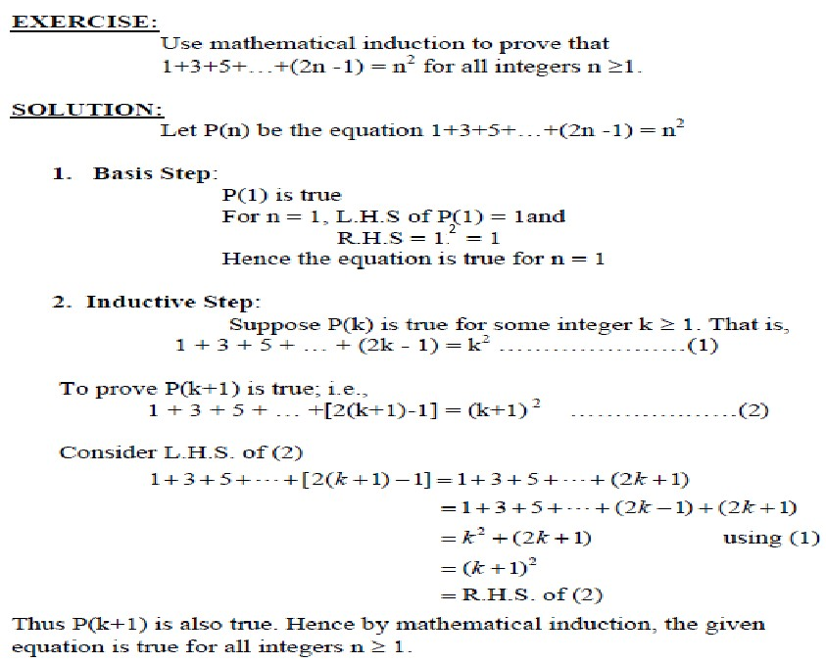

Slide 21
